Slide 1
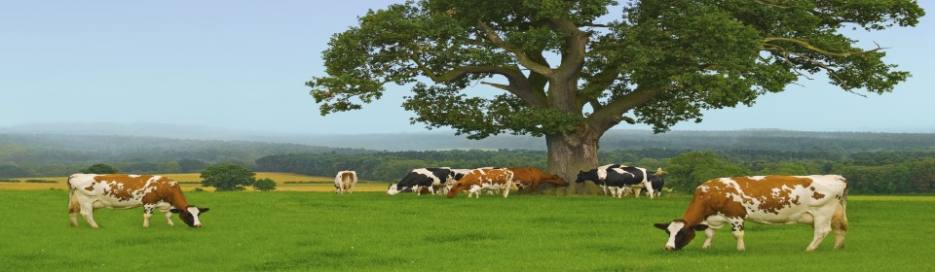
Design and Implementation of Livestock ManAgement System
By: Fapohunda Blessing Omolola (2015070501205)
Supervisor: Mr. G.G.O Egbedokun

Slide 2
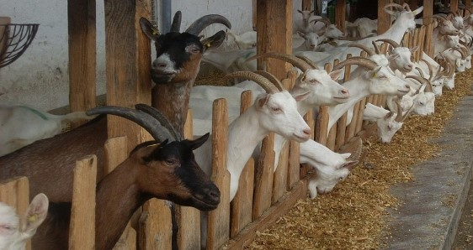
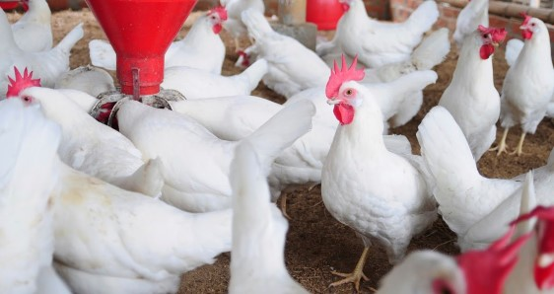
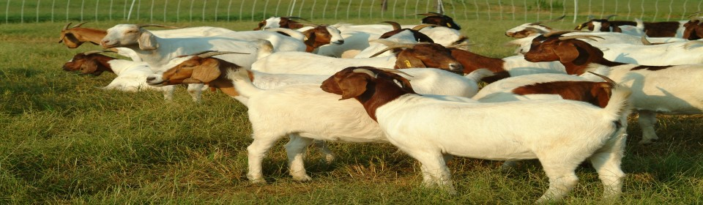
INTRODUCTION
Livestock have long been crucial for more than just food, especially in developing countries where they support livelihoods and provide essential resources like manure and draught power. As agricultural practices shift towards more intensive production, challenges such as social, economic, and environmental constraints have emerged. This study focuses on developing a Computerized Livestock Management Information System to address these challenges and improve livestock management in modern agriculture.

Slide 3
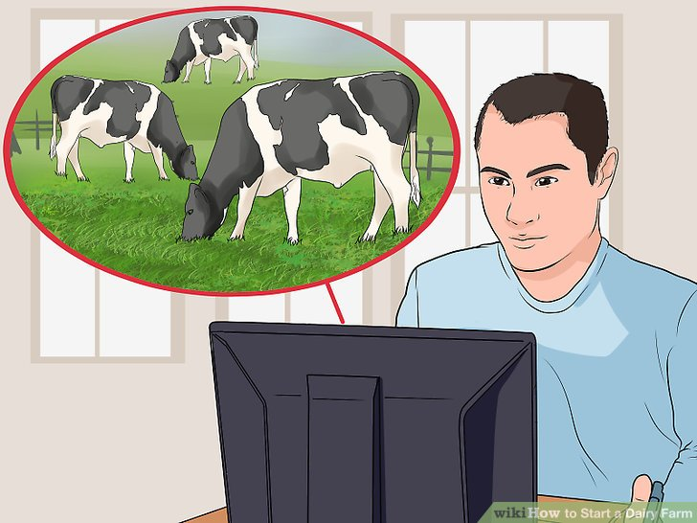

STATEMENT OF THE PROBLEM:
Livestock play an important role in feeding the people and more so the nation’s economy. Over the past years, considerable changes have taken place in populations of livestock and the composition of livestock holdings, as well as in the management strategies, as a result of population growth and land use intensification. The problems includes the different social, economic, environmental and political constraints to livestock production systems.

Slide 4
LITERATUR REVIEW
Livestock is increasingly important in the global economy, with projected growth in meat and milk demand exerting pressure on natural resources. In developing countries, livestock is vital for providing food, income, employment, and other essential services like draught power and organic fertilizer. Livestock also plays a crucial role in maintaining soil fertility, particularly in regions where chemical fertilizers are not available or affordable.
Globally, livestock occupies a significant portion of agricultural land, supporting millions of pastoral and smallholder farmer families. In countries like nepal, tibet, and ethiopia, livestock contributes a substantial portion of agricultural income and GDP. Additionally, livestock serves as an important financial asset for rural populations, offering investment and insurance in areas with limited access to formal banking.
Overall, livestock is integral to both economic development and environmental sustainability, making effective management essential as global demand continues to rise.

Slide 5
AIM and objectives of the study
The aim of the study is to design and implement a computerized livestock management information system in modern pig farming for Zartech Limited Ibadan.
To design a computerized livestock management information system
To keep managers, staff and the entire organisation abreast of happenings throughout the production units.
To combat fatigue in the process, which is caused by stressing out individuals in the farm
To facilitate a proper management of time and forecasting the production process from day one to sales point.

Slide 6
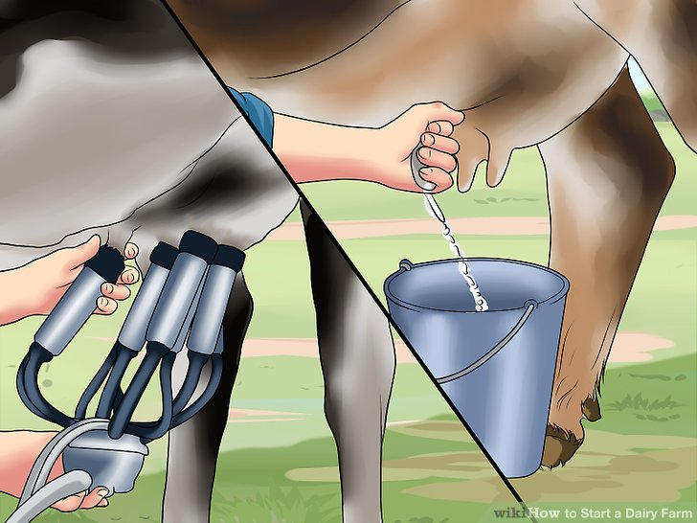
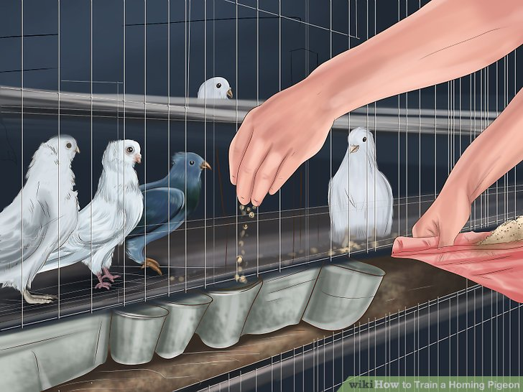
METHODOLOGY
Research design: mixed-methods approach to explore and validate a computerized livestock management system.
Existing system operation: manual record-keeping with physical ledgers and basic digital tools, prone to errors and inefficiencies.
Data collection methods: surveys, interviews, and observations of current practices.
Data analysis: statistical analysis of quantitative data and thematic analysis of qualitative data.
System development: create a computerized system for automated data entry, processing, reporting, and centralized storage.
Testing and validation: pilot testing with user feedback to refine the system.
Evaluation: compare new system performance with the manual system on

Slide 7

RESULT OBTAINED (Admin login)

Slide 8
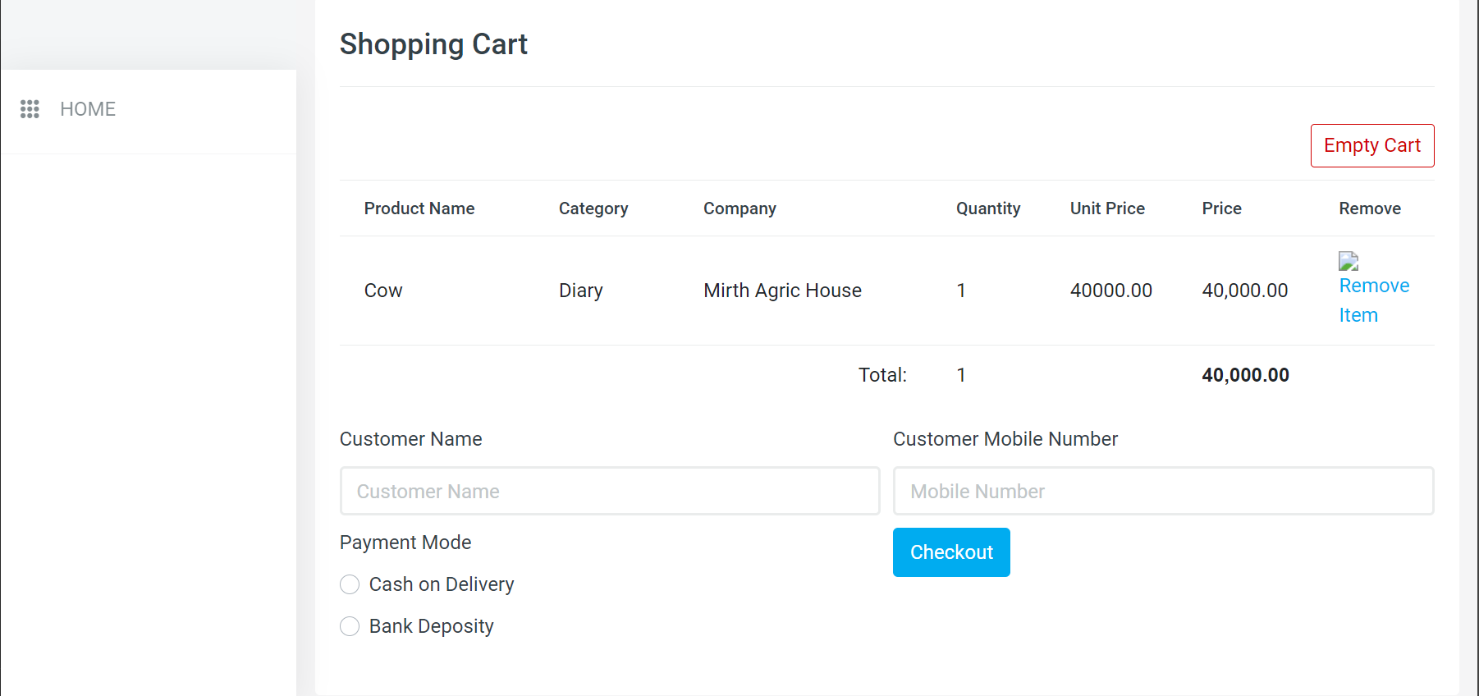
RESULT OBTAINED (Customer shopping cart)

Slide 9
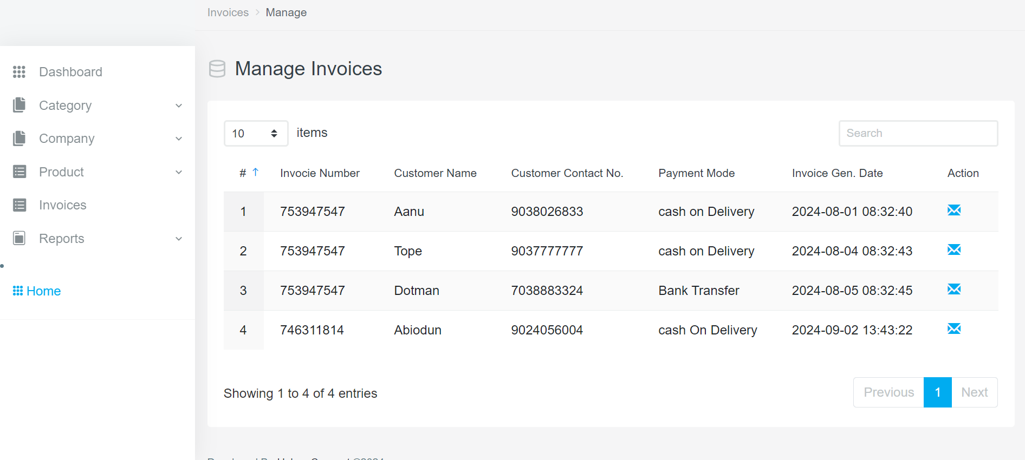
RESULT OBTAINED (customer invoice)

Slide 10
REFERENCES
Aubry, C., Galan, M. B. & Maze, A. (2005) “HACCP methodology and quality / environmental
Specifications for crop farms: implications for the design of good agricultural practices guidelines”, cashiers agricultures, vol. 14, pp. 313-322
Banhazi, T., Black, J. L. & Durack, M. (2003). “Australian precision livestock farming workshops”, in joint conference of ECPA – ECPLF, werner, A. & Jarfe, A.(Editor), berlin, germany, wageningen academic publisher, vol. 1, pp. 675-684.
Banhazi, t., Black, J. L., Durack, M., Cargill, C., King, A. & Hughes, P. (2002a). “Precision livestock farming”, in proceedings of the australian association of pig veterinarians conference, adelaide, australia, australian association of pig veterinarians, vol. 1, pp. 103-110.
Banhazi, t., Dunn, M., Cook, P., Black, J., Durack, M. & Johnnson, I. (2007b). “Development of precision livestock farming (PLF) technologies for the australian pig industry”, in 3rd european precision livestock farming conference, cox, S. (Editor), university of thessaly, skiathos, greece, vol. 1, pp.219-228.
Beattie, v. (2001). “Environmental design for pig welfare”, in integrated management systems for livestock, wathes, C. M. (Editor), selwyn college, cambridge, UK, BSAS, edinburgh, pp. 97-103.
Black, j. L. 2001, “swine production – past, present and future”, in palestras XXXVII
Reuniao annual sociedadebrasileira de zootecniabrazil ,sociedadebrasileira do zootecnia.
Black, j. L. (2002). “Experience in the successful adoption of AUSPIG by industry”, in animal
Production inaustralia, taplin, D. & Revell, D. K. (Editor), adelaide, south australia, vol. 24, pp. 442-448.

